Slide 1

Gradient descent

Slide 2
Introduction
In this topic, we will
  Describe why we might not want to use one of the two previous algorithms
  Discuss the idea of the gradient
  See how the gradient can indicate which direction to search
  Explain how we can convert an n-dimensional minimization problem into a one-dimensional minimization problem
  Discuss issues with estimating the gradient

Slide 3
The problem
We have seen algorithms to approximate the minimum of
a real-valued function of a real variable
We have also seen how Newton’s method can be used if
we can calculate the gradient and the Hessian
If we cannot calculate the Hessian, we could revert to the
Hooke-Jeeves method
What if, however, the function is sufficiently differentiable
  Can we develop a better approach?

Slide 4
The gradient
Given a sufficiently differentiable real-valued function of a vector variable,
the gradient is defined as
We can normalize this gradient vector by dividing by its 2-norm,
and denote a normalized vector by a hat:

Slide 5
The gradient
Evaluating the gradient at a point u_{k} gives us the direction of maximum increase
  Thus for sufficiently small ε > 0,
Similarly, for a sufficiently differentiable function,
the opposite direction gives the direction of maximum
decrease:

Slide 6
The gradient
Mathematically, we say this as follows:
  The slope in the direction of the gradient is greater than or
  equal to the slope in any other direction
Also,

Slide 7
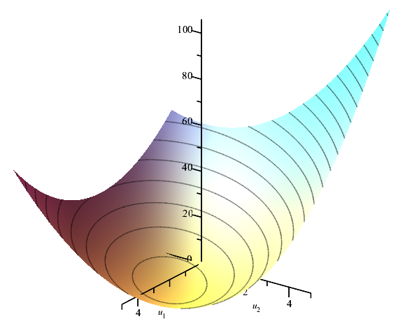
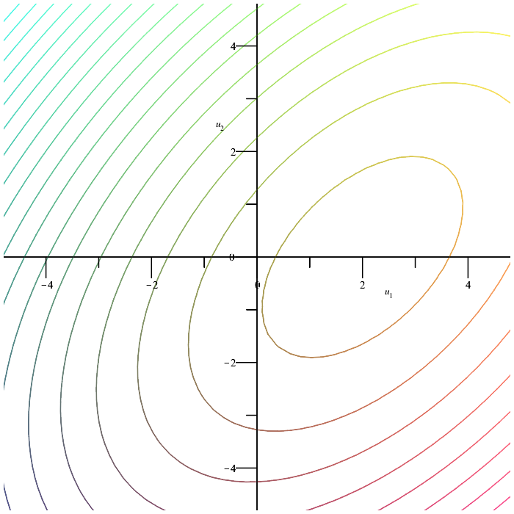
The gradient
For example, consider the bivariate function:
  This function has a unique minimum at the point

Slide 8
The gradient
For this function,
  At the point , we have

Slide 9
The gradient
Viewing this visually, we have

Slide 10
The gradient
Now, if for α > 0 moves in the direction of steepest ascent,
then for α > 0 moves in the direction of steepest descent

Slide 11
The gradient
The opposite direction is the direction of steepest descent,
but it does not point directly at the minimum
  It does, however, move us in the direction of that minimum

Slide 12
A real-valued function of a real variable
Notice now that has one real variable α
Thus, is a real-value function of a real variable
In our example, we had
Substituting this into the function, we have:

Slide 13
Possible strategies
Once we find the gradient at u_{k}, we have one of two strategies:
  Move one step in that direction and try again
  Find a local minimum in that direction and only then try again

Slide 14
Possible strategies
Analogies are as follows: determine the direction of steepest descent and:
  Take one step in that direction
  Move in that direction until you start going uphill

Slide 15
Possible strategies
Taking one step and then recalculating the gradient may require significant computational effort at each step
  Also, how do we pick the optimal step size?

Slide 16
Possible strategies
The second strategy, searching in the direction of the gradient,
we calculate the gradient once, but then use a solver
for minimizing a real-valued function of a real variable

Slide 17
Minimizing in the direction of the gradient
Suppose we adopt this second strategy
  Given u_{k}, we calculate the gradient and find u_{k+1}
  If we calculate the gradient at u_{k+1}, you will find that
u_{k}
u_{k+1}
u_{k}
u_{k+1}

Slide 18
Minimizing in the direction of the gradient
How do we find a minimum in this direction?
  Previously, we assumed we had an idea as to where the minimum was
  Strategies vary, but we will focus on one additional assumption

Slide 19
Minimizing in the direction of the gradient
We will assume that:
  The function has a unique minimum and is concave up
  The function, in any direction, ultimately goes to infinity
If both these conditions are satisfied,
both these conditions are also satisfied on any line

Slide 20
Minimizing in the direction of the gradient
Now, begin calculating
starting with m = 0
Begin incrementing or decrementing m until you find three points such that
In this case, you then continue with the golden-ratio search
with
starting with φ^{M–1} ≤ α ≤ φ^{M+1} and continuing with the Brent-Dekker method

Slide 21
Minimizing in the direction of the gradient
In our example, we’d proceed as follows
  Thus, start searching between φ ≤ α ≤ φ³
}

Slide 22
Minimizing in the direction of the gradient
Some caveats:
  Should you always start with m = 0?
    No, after the first iteration,
    you should probably start with the previous M you found
  As you approach the minimum, it may happen that a range
  of powers may be equal (and very close to the minimum value):

Slide 23
Calculating or estimating the gradient
In general:
  If automatic differentiation is being used to calculate the gradient, automatic differentiation can be used to calculate the Hessian, so you should consider using Newton’s method
  If the function f is not sufficiently differentiable to calculate the Hessian, but you can still calculate the gradient, use this technique
  If automatic differentiation is not available,
  we can still estimate the gradient
    This is possible because of the properties of extrema
    if the solution is differentiable near the extremum
    An approximation of the gradient will still move us in the direction of the minimum

Slide 24
Calculating or estimating the gradient
To approximate the gradient:
  Recall that e_{k} is the k^{th} canonical unit vector:
    All entries are zero except for the k^{th} entry, which is one
  In this case,

Slide 25
Calculating or estimating the gradient
Recall that for ,
we had and
Letting h = 0.1, we can approximate the two entries:

Slide 26
Calculating or estimating the gradient
Is it safe to use an approximation of the gradient?
  Recall that at a minimum, there will be an entire region where
  the truncated floating-point values will be equal
  There will also be a much larger region where the value of
  the function is close to the minimum value
Thus, we are still likely to find a good approximation of the
minimum value, even if we don’t have that ideal an
approximation of exactly where that minimum is

Slide 27
Summary
Following this topic, you now
  Understand the idea of gradient descent
    If the gradient points in the direction of maximum increase,
    the opposite direction points in the direction
    of maximum decrease
  Understand that you should move in that direction until you
  find a local minimum
  Are aware that this reduces the number of times we must
  actually calculate the gradient—an expensive operation
  Know that you can approximate the gradient by using finite
  difference formulas and that these are likely sufficiently
  accurate to help find that minimum

Slide 28
References
[1] https://en.wikipedia.org/wiki/Gradient_descent

Slide 29
Acknowledgments
None so far.

Slide 30



Colophon
These slides were prepared using the Cambria typeface. Mathematical equations use Times New Roman, and source code is presented using Consolas. Mathematical equations are prepared in MathType by Design Science, Inc.
Examples may be formulated and checked using Maple by Maplesoft, Inc.
The photographs of flowers and a monarch butter appearing on the title slide and accenting the top of each other slide were taken at the Royal Botanical Gardens in October of 2017 by Douglas Wilhelm Harder. Please see
https://www.rbg.ca/
for more information.

Slide 31
Disclaimer
These slides are provided for the ece 204 Numerical methods course taught at the University of Waterloo. The material in it reflects the author’s best judgment in light of the information available to them at the time of preparation. Any reliance on these course slides by any party for any other purpose are the responsibility of such parties. The authors accept no responsibility for damages, if any, suffered by any party as a result of decisions made or actions based on these course slides for any other purpose than that for which it was intended.

